Slide 1
Recommendation on Ticket Price & Facilities Adjustments
Created for Big Mountain Resort
by Boardspring Analytics
Septembruary 39st, 2048

Slide 2
Problem Identification
Big Mountain enlisted Boardspring Analytics
for help with 3 core business problems:
1. Big Mountain did not have a data-driven price point.
Previously, the resort has simply pegged its ticket price to the average price of resorts in its market segment without analyzing potential for increases.
2. Big Mountain did not understand the ROI of its facilities.
The resort did not know which of our facilities are driving ticket sales and which are not earning back their own operating costs.
3. Big Mountain must cover the $1.5mil operating cost increase from the new lift.
The resort built the lift without understanding the specific ROI and is at risk of running at a loss without adjustments to prices or facilities.

Slide 3
Problem Identification
Based on these 3 problems, our mission was clear:
We will determine an optimal ticket price and adjustments to facility offerings…
that will increase revenue by at least $1.5mil/year…
to be implemented before tickets for next season go on sale.

Slide 4

Boardspring’s Solution Process
Boardspring Analytics engaged with the problem
using a data-driven, machine learning approach:
Analyze competitor data
By investigating the relationship between our competitors’ prices and facilities, we can get an idea of how our customers value our specific offerings.
Model the results
We used rigorous machine learning techniques to uncover and quantify the relative effect of different facility offerings on competitors’ market prices.
Produce actionable
recommendations
We now know the optimal price point for our facilities and can also offer a facilities adjustment plan to maximize the resort’s profit margin.

Slide 5
Recommendation Summary
Pricing Recommendation
Facilities Recommendations
Big Mountain’s offerings support a ticket price increase of ~$14, from $81 per adult weekend ticket to $95 (+-$10).
With the expected annual visitor count to be 350,000 and the average number of daily tickets per visitor to be 5, this price increase could increase annual revenue by about $24.5mil.
1. Closing our least-used run would reduce operating costs while having no measurable impact on revenue.
2. Extending our longest run by 0.2 miles, accompanied by a 4-acre increase in snow production, could support a further price increase that could additionally increase revenue by over $3mil.

Slide 6
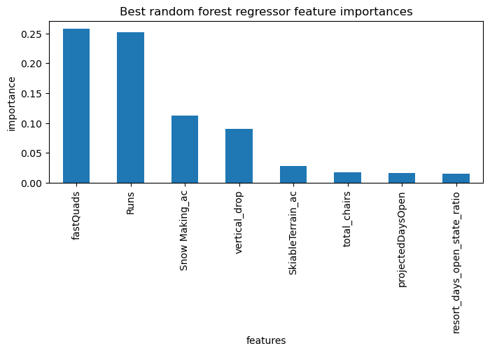
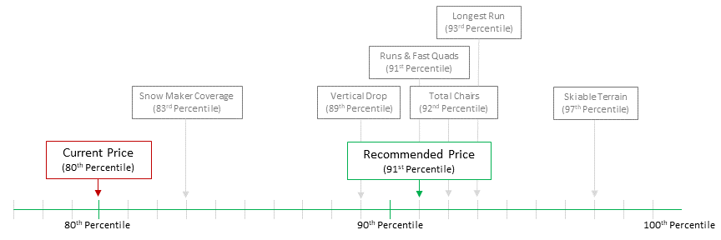
Methodology – Ticket Price Recommendation
4 of 32 offerings considered were most influential on ticket price…
…and Big Mountain’s current price lags far behind its ranking on all of these offerings.
Fig1: The relative importance of the top 8 features shows a clear influence drop-off after the first 4.
Fig 2: While Big Mountain beats over 90% of competitors on most of the key offerings, it is only charging more than 80% of its competitors.

Slide 7
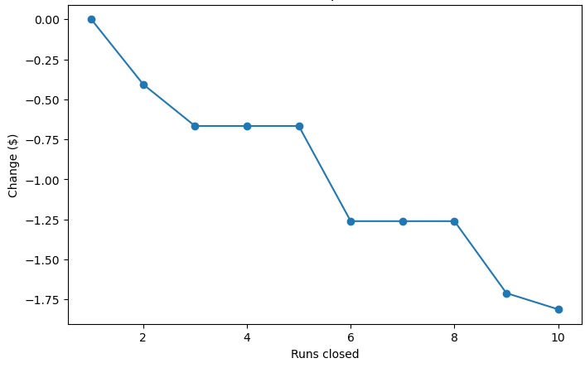
Methodology – Facilities Recommendations
Closing 1 run would have no effect on the chargeable ticket price.
Extending our longest run by 0.2mi with a potential 4 additional acres of snow coverage would increase chargeable ticket price without significant operating cost increases.
Predicted ticket price increase from 0.2mi extension and 4 acres of snow coverage: $1.99
Resulting increase in annual revenue: $3,474,638
Fig3: If Big Mountain opts to close more than one run to find the optimum ROI, we suggest closing one per year to ensure that the observed results match the model over time.

Slide 8
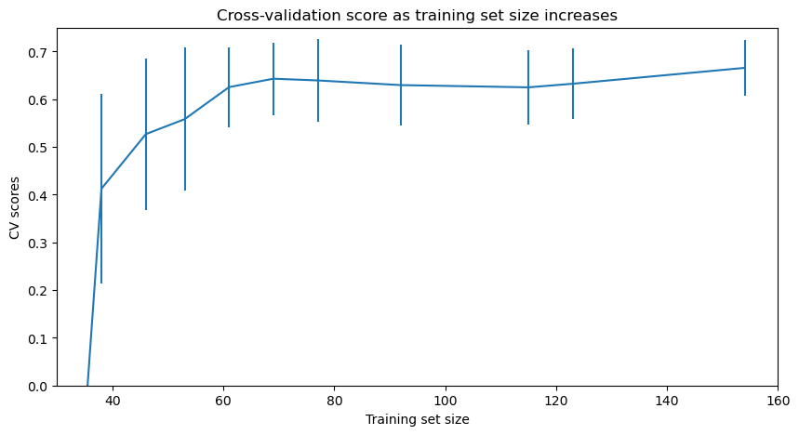
Methodology – Results Testing & Interpreting
We already have enough data to make consistent predictions.
We have a range of +-$10 to adjust the ticket price around the model’s suggestion of $95.
The Mean Absolute Error (MAE) of the model is $10, meaning that the model’s predictions are largely accurate to within $10 of a resort’s actual price.
Given this range, we recommend consulting the marketing team to arrive at a specific number within this range that will appeal to consumers.
Fig4: Our model’s accuracy plateaus at a sample size of 70, meaning that we already have enough data for a strong model. A CV score of 1 means that the model predicts each value exactly; ours retains a margin of error of +-$10, as calculated by the Mean Absolute Error of our predicted values against the test data.

Slide 9
Conclusion
Success Story:
Initial Problems
Achieved Solutions
Big Mountain had no data-driven price point.
We leveraged machine learning and determined a data-driven optimal price range of $95 (+-$10)
We performed random forest modeling on competitor data and uncovered which facilities drive value and which can be cut back.
Big Mountain did not understand the ROI of its facilities.
Big Mountain must cover the $1.5mil operating cost increase from the new lift.
Our combination of a new price point and strategic facilities reduction can lead to a revenue increase of $24.5mil.

Slide 10
Thank You
Created for Big Mountain Resort
by Boardspring Analytics
Septembruary 39st, 2048

